Slide 1
聚力科技大数据 洞察科技创新机遇
真溱
2018年5月25日 吉林大学

Slide 2
从Sensemaking （意义构建）说起
How we gain a necessary understanding of relevant parts of our world. Everyone does it. 【朴素版描述】 (Mark Stefk)
A set of philosophical assumptions, substantive propositions, methodological framings, and methods … It includes an interpretation of the results of that analysis and synthesis. It is sometimes referred to as an approach to creating situational awareness “in situations of uncertainty.” 【在不确定环境下获得形势/局势感知】(David T. Moore)
David T. Moore，Sensemaking: A Structure for an Intelligence Revolution，NATIONAL DEFENSE INTELLIGENCE COLLEGE，2011

Slide 3
Sensemaking 意义构建
Intelligence sensemaking encompasses the processes by which specialized knowledge about ambiguous, complex, and uncertain issues is created. This knowledge is generated by professionals who in this context become known as Intelligence Sensemakers. (David T. Moore)【围绕模糊的、复杂的、不确定的问题，提供专门的知识（情报产品）】
David T. Moore，Sensemaking: A Structure for an Intelligence Revolution，NATIONAL DEFENSE INTELLIGENCE COLLEGE，2011

Slide 4
问题随之而来……
“意义构建”跟我（科技情报人员）有关系吗？
科技情报人员所做的，跟（科技）决策者有什么关系？
为决策者（包括决策者本人以及为他们提供重要咨询意见的智囊）订了他想要的期刊（例如《Science》）或者其他数据库，或者进一步，把某些内容编译出来，他的需求就满足了吗？
决策者真正想要的是什么？

Slide 5
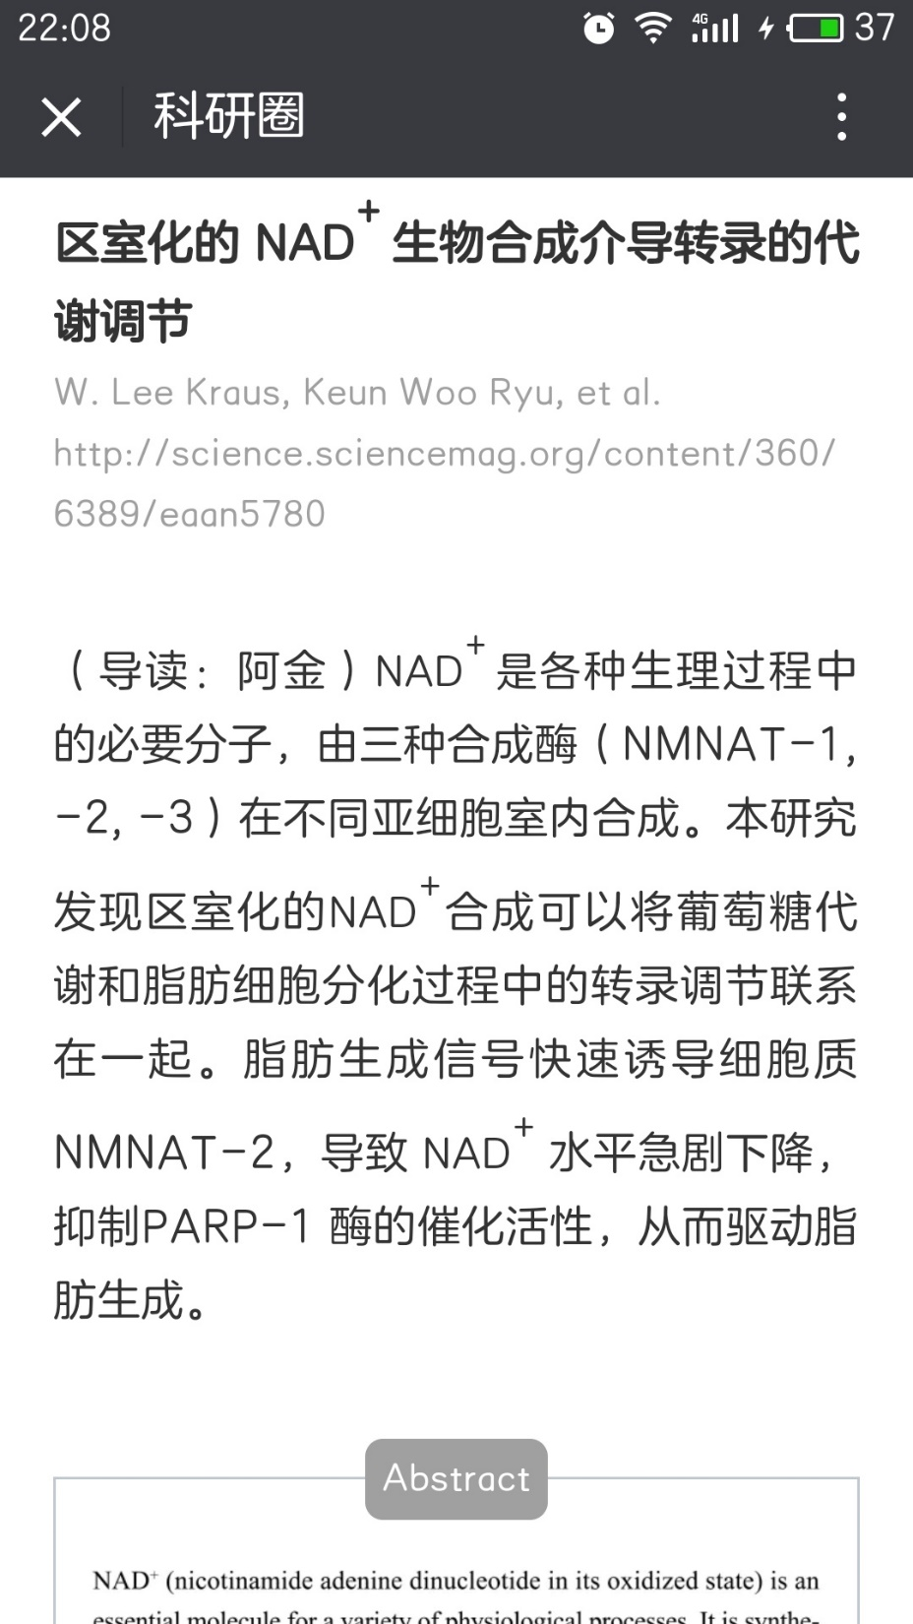
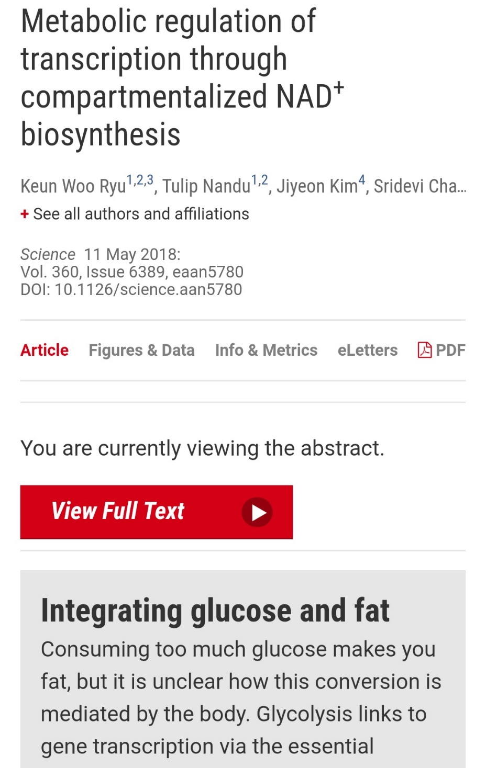
举个例子

Slide 6
举个例子……
我（所在的机构）应该关心吗？
跟（我所在的机构掌握或者能获得的）现有其他技术相比，取得哪些突破？有哪些优势？
距离实用或者商用还有多远？
造价？市场前景？政策或法律限制？……
是否意味着一个新的创新机遇（决策选项）
通常情况下，回答的难度越来越大，答上来的可能性越来越小；
与决策者“意义构建”的预期距离越来越大
http://robotics.sciencemag.org/content/3/16
Notes:
这里的创新，较为狭义
为什么？

Slide 7
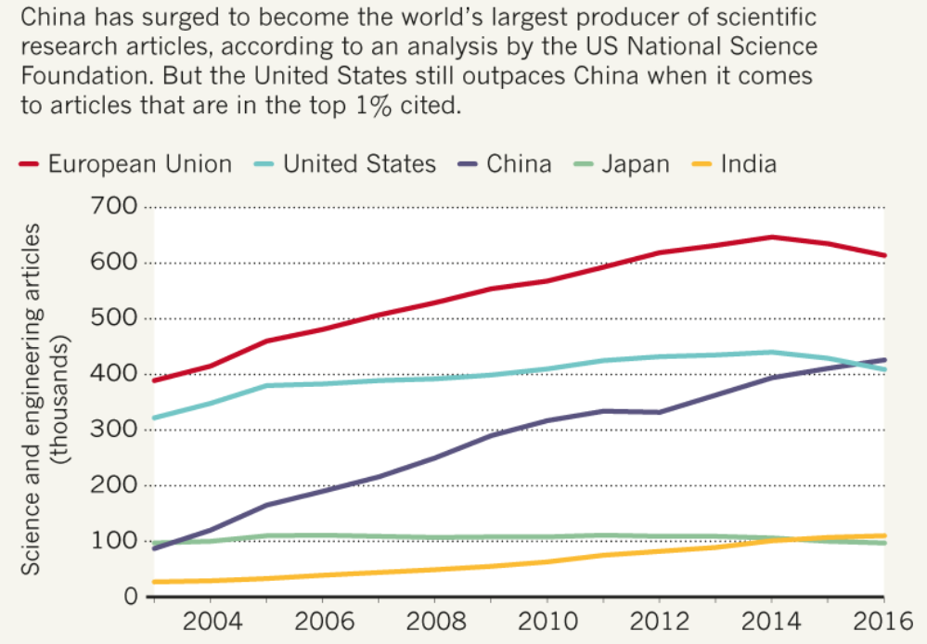
从“论文大国”“专利大国”到科技强国
全球范围内，中国从2011年起即已成为专利申请第一大国。而新现象是，在中国国内申请的专利数量首次超过美、欧、日、韩的总和。
德媒：中国已成经济和专利大国 美国不再是“丛林之王”，2018-03-18，http://www.cankaoxiaoxi.com/china/20180318/2258738.shtml
进一步提高论文质量？
进一步提高原始创新比例？
进一步提升“创新获得感”？
Jeff Tollefson，China declared world’s largest producer of scientific articles，Nature,2018-01-18，https://www.nature.com/articles/d41586-018-00927-4
Notes:
论文多、专利多，就是创新多？可能对某些高校
进一步提高论文质量=》挤核心刊/顶会独木桥

Slide 8
何为“创新”？来自3M的经验
创意（creation/creativity/creative idea/novel idea）≈ 新想法
发明（invention） ≈ 新专利
创新（innovation） ≈ 改变，被社会接受的新方式/方法/模式，新产品
Art Fry，Creativity, Innovation and Invention: A Corporate Inventor’s Perspective，http://www.cpsb.com/research/communique/new-product-development/Art-Frey-Creativity-and-Innovation.pdf
科研就是把钱转化为知识，创新就是把知识转化为钱。
成立于1902年的3M公司，截至2017年7月，已累计获得112,043项专利，即从公司成立起每天平均获得2.7项专利。
它拥有5.5万多种技术产品，目前每周发布25种新产品。
武夷山，3M公司的5条创新经验，2017-11-18，http://blog.sciencenet.cn/blog-1557-1085739.html
Notes:
广义的“创新”，包括创意、发明、创新；狭义的“创新”…
接下来，创新的获得感，对决策者而言，

Slide 9
决策者的“创新获得感”
决策者的创新获得感，就是将创新机遇转变为决策选项（actionable option）
决策者需要
识别创新机遇
在资源相对不足的情况下，面对多个决策选项，进行决策
Notes:
就是形成“决策选项”… 决策的困境在于多个选择…

Slide 10
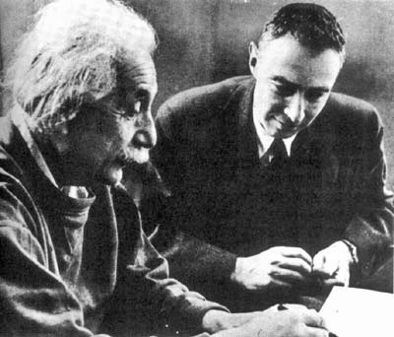
多选项决策：“曼哈顿工程”
核裂变材料分离与浓缩：
铀
Gaseous diffusion 气体扩散
Electromagnetic separation 电磁分离
Liquid thermal diffusion 液体热扩散
钚
Chemical separation （pile process）化学分离
Concurrent development 并行开发
“财大气粗”
时敏任务
领跑状态
Notes:
专家投票取得一致意见？

Slide 11
多选项决策：导弹优先还是飞机优先
1956年2月17日，钱学森提出了《建立我国国防航空工业意见书》。在这个意见书中，他分析了当时我国航空工业的现状后指出：“我国现在航空工业是十分薄弱的，我们在最近才从飞机修理阶段转入飞机生产阶段，有了飞机工厂和喷射式推进机【喷气发动机】厂。但是这两个工厂现在完全依靠苏联供给的图纸。自己还不能够设计新型飞机，更不能做出为设计用的工程及科学资料。至于飞弹【导弹】火箭，我们是完全没有。”在这个意见书中，他还重点分析了航空材料和风洞建设与国际水平的差距。不久，钱老在上述分析的基础上，提出了优先发展导弹的建议。
苏联领导人建议中国要在发展飞机的基础上再发展导弹，空军司令刘亚楼力挺先发展飞机等主张，钱学森提出“导弹优先”的建议需要很大的勇气。
经济实惠
研仿/跟跑状态
黄志澄，莫要误读钱学森优先发展导弹的建议，http://blog.sina.com.cn/s/blog_45c07ebd0101d2u1.html

Slide 12
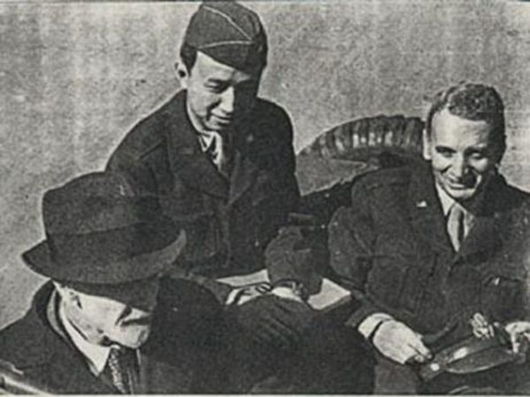
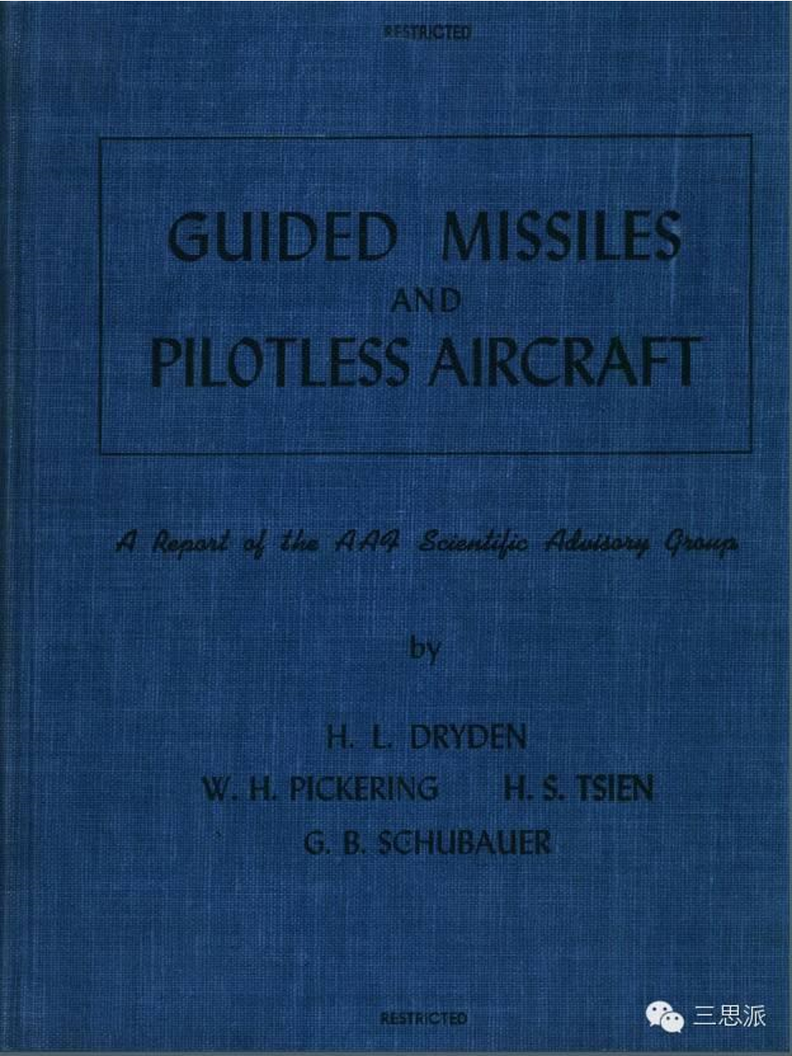
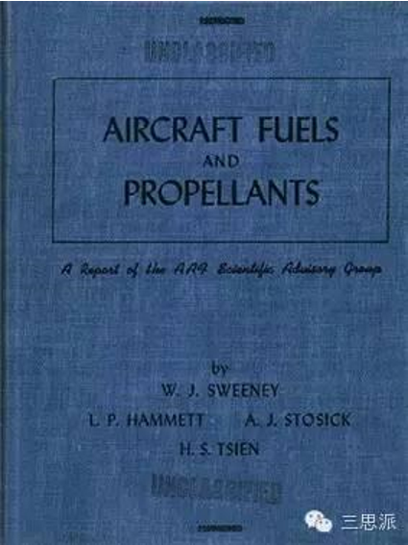
钱学森的数据储备知识储备
1944年美国陆军航空兵司令阿诺德将军请加州理工学院的冯·卡门全面评估和预测未来的空中力量。钱学森作为冯·卡门的助手，赴欧洲（重点是德国）和亚太考察，后作为主要执笔人之一，参与完成了《Where We Stand》《Towards New Horizons》两份报告。
三思派，钱学森归国时带回的“机密文件”——他的“火箭”人生与新中国十二年科学规划，
https://www.toutiao.com/i6246936658298536449/

Slide 13
钱学森的数据储备知识储备
钱学森在1945年8月到1950年10月间，制作了一套英文剪报，9册400多页2000余份。内容涉及原子弹、核技术、导弹火箭等多个领域。其中，最多的是关于原子弹的报道。
三思派，钱学森归国时带回的“机密文件”——他的“火箭”人生与新中国十二年科学规划，
https://www.toutiao.com/i6246936658298536449/

Slide 14
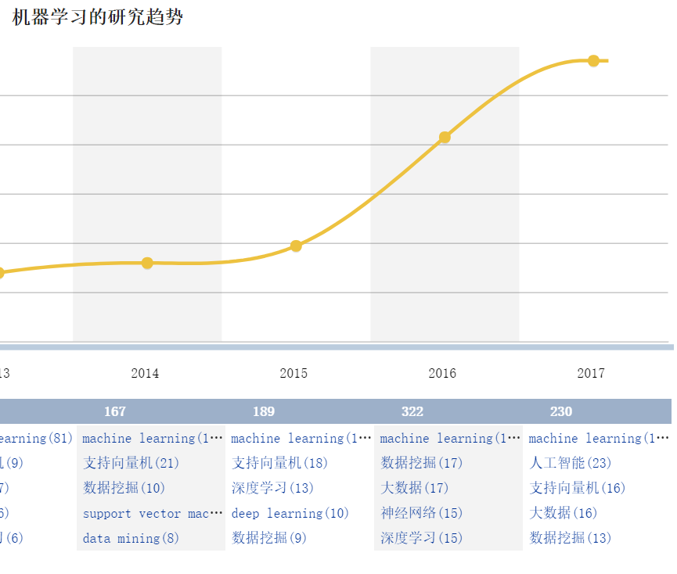
再举一个例子……
能表达与深度学习的关系？
能反映该领域的主要方面：人工介入程度（如半监督）、算法（如卷积神经网络）、支撑库（如Tensorflow）、芯片（如寒武纪）、应用（如人脸识别）？
能揭示深层原因？
（对机构）有意义的结论？成熟度？市场？

Slide 15
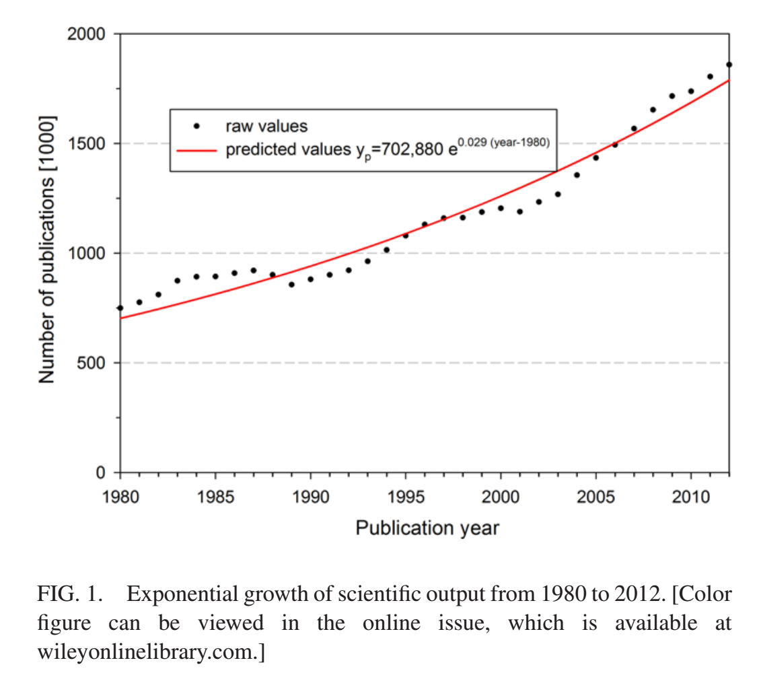
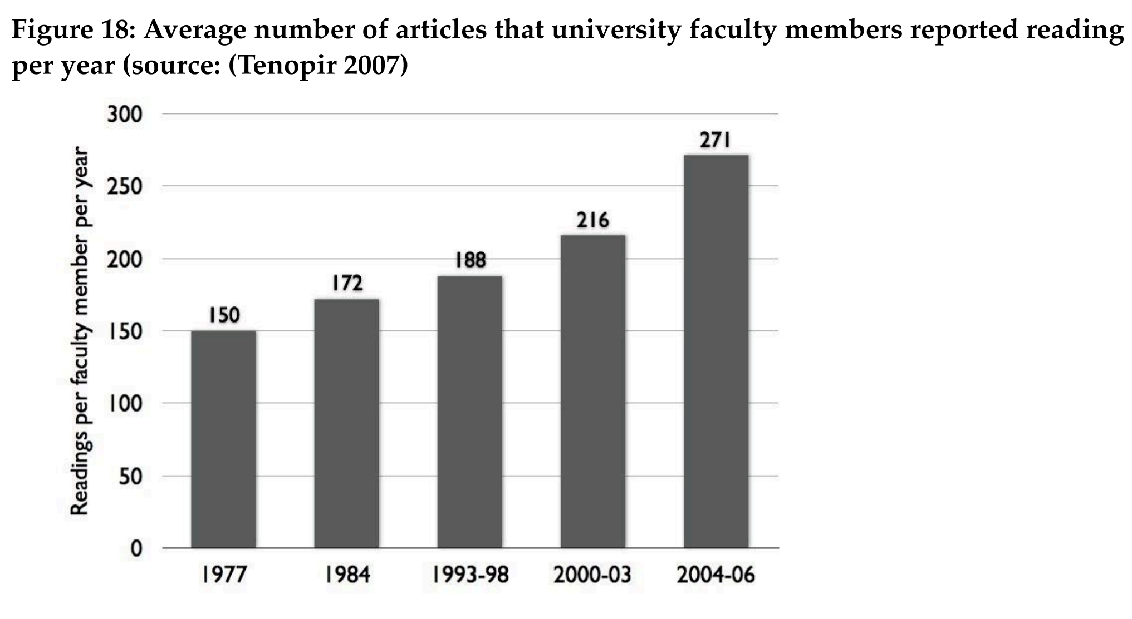
数据储备知识储备何其难也
Lutz Bornmann, Rüdiger Mutz，Growth Rates of Modern Science: A Bibliometric Analysis Based on the Number of Publications and Cited References，JOURNAL OF THE ASSOCIATION FOR INFORMATION SCIENCE AND TECHNOLOGY, 66(11):2215–2222, 2015
Mark Ware, Michael Mabe，The STM Report: An overview of scientific and scholarly journal publishing，2015
Notes:
p53

Slide 16
决策的困境
从技术（进展、趋势）信息到创新机遇（决策选项，actionable）的鸿沟，可以称为对科技的“意义构建”鸿沟
相关性判断
重要性判断，突破是大还是小？是新原理新机理新算法还是小修小补、物料堆砌？
实用性判断，理论成果？实验室成果？大规模实验？带噪音的实际环境实验？
……
数据储备和知识储备，以及投入的工作量（时间），对形成决策选项有重要影响

Slide 17
填补鸿沟的科技大数据之路
用（大）数据储备来弥补知识储备的不足，既包括科技本身的各种知识，也包括科研活动主体的各种知识
用大数据工具来弥补工作量投入（尤其是时间）的紧张
总之：利用科技大数据及其工具，增强决策者对科技（进展、创新、成果）的理解力，为决策者提供更为扎实的决策选项

Slide 18
科技大数据及其工具
科技大数据，包含但不限于下列类型
（外源性）科技文献：期刊论文、会议论文（和讲义）、学位论文、研究报告、专利、标准、百科…
（外源性）科研消息报道、政策法规、博文短评…
（非正式/隐性）专家口头交流…
机构内部自产的相关数据和文献
科技大数据工具，具有但不限于下列功能
[较传统]采集、（关键词、命名实体、事件）抽取、索引、检索
过滤、关联、统计、排序、（专家、机构、技术）画像、预测
Notes:
[展望]情报对象的发现/甄别、锁定/解锁、实证/判断、预置/快反

Slide 19
数据—工具—解决方案
填补知识鸿沟
建立敏锐感知，跟踪最新动向，识别新兴技术
提供决策选项，发现潜在对手，寻找合作伙伴，评估技术价值，
预测应用前景
方案层
针对决策需求
工具层
提供支撑功能
采集
抽取
（关键词、命名实体、事件）
检索
过滤
关联
排序
统计
画像
（专家、机构、技术）
预测
资源层
提供数据基础
（外源性）科技文献：期刊论文、会议论文（和讲义）、学位论文、研究报告、专利、标准、百科…
（外源性）科研消息报道、政策法规、博文短评…
（非正式/隐性）专家口头交流…
机构内部自产的相关数据和文献
Notes:
要形成方案，有必要对科技创新活动建立一种（简化的）模型

Slide 20
理解科技创新活动（一种模型）
Research, Development, Test and Evaluation，研究，开发（研制），试验，鉴定（评估）
01 - Basic Research，基础研究
02 - Applied Research，应用研究
03 - Advanced Technology Development，高新技术开发
04 - Advanced Component Development and Prototypes，高新组件与原型开发
05 - System Development and Demonstration，系统开发与验证
06 - RDT&E Management Support，研发试验鉴定管理
07 - Operational System Development，运行（作战）系统开发
根据美国国防部指示3200.12，
01-03 属于科研
DoD 7000.14 – R，DEPARTMENT OF DEFENSE FINANCIAL MANAGEMENT REGULATION, VOLUME 2A: “BUDGET FORMULATION AND PRESENTATION (CHAPTERS 1-3)”, p1-141

Slide 21
Basic Research 基础研究
Basic research is systematic study directed toward greater knowledge or understanding of the fundamental aspects of phenomena and of observable facts without specific applications towards processes or products in mind. 【不针对特定应用】
It includes all scientific study and experimentation directed toward increasing fundamental knowledge and understanding in those fields of the physical, engineering, environmental, and life sciences related to long-term national security needs. 【基础知识】
It is farsighted high payoff research that provides the basis for technological progress.
DoD 7000.14 – R，DEPARTMENT OF DEFENSE FINANCIAL MANAGEMENT REGULATION, VOLUME 2B: “BUDGET FORMULATION AND PRESENTATION (CHAPTERS 4-19)“, p5-4

Slide 22
Basic Research 基础研究
Basic research may lead to:
(a) subsequent applied research and advanced technology developments in Defense-related technologies, and
(b) new and improved military functional capabilities in areas such as communications, detection, tracking, surveillance, propulsion, mobility, guidance and control, navigation, energy conversion, materials and structures, and personnel support.
Program elements in this category involve pre-Milestone A efforts.【里程碑A之前】
DoD 7000.14 – R，DEPARTMENT OF DEFENSE FINANCIAL MANAGEMENT REGULATION, VOLUME 2B: “BUDGET FORMULATION AND PRESENTATION (CHAPTERS 4-19)“, p5-4

Slide 23
Applied Research 应用研究
Applied research is systematic study to understand the means to meet a recognized and specific need. 【特定需求】
It is a systematic expansion and application of knowledge to develop useful materials, devices, and systems or methods.
It may be oriented, ultimately, toward the design, development, and improvement of prototypes and new processes to meet general mission area requirements.
DoD 7000.14 – R，DEPARTMENT OF DEFENSE FINANCIAL MANAGEMENT REGULATION, VOLUME 2B: “BUDGET FORMULATION AND PRESENTATION (CHAPTERS 4-19)“, p5-4

Slide 24
Applied Research 应用研究
Applied research may translate promising basic research into solutions for broadly defined military needs, short of system development.
This type of effort may vary from systematic mission-directed research beyond that in Budget Activity 1 【基础研究】to sophisticated breadboard hardware, study, programming and planning efforts that establish the initial feasibility and practicality of proposed solutions to technological challenges.
It includes studies, investigations, and non-system specific technology efforts.
DoD 7000.14 – R，DEPARTMENT OF DEFENSE FINANCIAL MANAGEMENT REGULATION, VOLUME 2B: “BUDGET FORMULATION AND PRESENTATION (CHAPTERS 4-19)“, p5-4

Slide 25
Applied Research 应用研究
The dominant characteristic is that applied research is directed toward general military needs with a view toward developing and evaluating the feasibility and practicality of proposed solutions and determining their parameters.
Applied Research precedes system specific technology investigations or development.
Program control of the Applied Research program element is normally exercised by general level of effort. Program elements in this category involve pre-Milestone B efforts, also known as Concept and Technology Development phase tasks, such as concept exploration efforts and paper studies of alternative concepts for meeting a mission need.【里程碑B之前，概念和技术开发阶段】
DoD 7000.14 – R，DEPARTMENT OF DEFENSE FINANCIAL MANAGEMENT REGULATION, VOLUME 2B: “BUDGET FORMULATION AND PRESENTATION (CHAPTERS 4-19)“, p5-4

Slide 26
Advanced Technology Development 高新技术开发
Advanced Technology Development (ATD) … includes development of subsystems and components and efforts to integrate subsystems and components into system prototypes for field experiments and/or tests in a simulated environment. 【集成，模拟环境】
[It] includes concept and technology demonstrations of components and subsystems or system models. The models may be form, fit, and function prototypes or scaled models that serve the same demonstration purpose.
DoD 7000.14 – R，DEPARTMENT OF DEFENSE FINANCIAL MANAGEMENT REGULATION, VOLUME 2B: “BUDGET FORMULATION AND PRESENTATION (CHAPTERS 4-19)“, p5-4~5-5

Slide 27
Advanced Technology Development 高新技术开发
The results of this type of effort are proof of technological feasibility and assessment of subsystem and component operability and producibility rather than the development of hardware for service use.
Projects in this category have a direct relevance to identified military needs.
Advanced Technology Development demonstrates the general military utility or cost reduction potential of technology when applied to different types of military equipment or techniques.
DoD 7000.14 – R，DEPARTMENT OF DEFENSE FINANCIAL MANAGEMENT REGULATION, VOLUME 2B: “BUDGET FORMULATION AND PRESENTATION (CHAPTERS 4-19)“, p5-4~5-5

Slide 28
Advanced Technology Development 高新技术开发
Program elements in this category involve pre-Milestone B efforts, such as system concept demonstration, joint and Service-specific experiments or Technology Demonstrations and generally have Technology Readiness Levels of 4, 5, or 6. (For further discussion on Technology Readiness Levels, see the Assistant Secretary of Defense for Research and Engineering’s Technology Readiness Assessment (TRA) Guidance.) 【里程碑B之前，技术成熟度4~6级】
Projects in this category do not necessarily lead to subsequent development or procurement phases, but should have the goal of moving out of Science and Technology (S&T) and into the acquisition process within the Future Years Defense Program (FYDP).
Upon successful completion of projects that have military utility, the technology should be available for transition.
DoD 7000.14 – R，DEPARTMENT OF DEFENSE FINANCIAL MANAGEMENT REGULATION, VOLUME 2B: “BUDGET FORMULATION AND PRESENTATION (CHAPTERS 4-19)“, p5-4~5-5

Slide 29
Advanced Component Development and Prototypes 高新组件与原型开发
Advanced Component Development and Prototypes (ACD&P) … necessary to evaluate integrated technologies, representative modes, or prototype systems in a high fidelity and realistic operating environment are funded in this budget activity.
The ACD&P phase includes system specific efforts that help expedite technology transition from the laboratory to operational use. 【从实验室/模拟环境到实际环境】
Emphasis is on proving component and subsystem maturity prior to integration in major and complex systems and may involve risk reduction initiatives.
DoD 7000.14 – R，DEPARTMENT OF DEFENSE FINANCIAL MANAGEMENT REGULATION, VOLUME 2B: “BUDGET FORMULATION AND PRESENTATION (CHAPTERS 4-19)“, p5-4~5-5

Slide 30
Advanced Component Development and Prototypes 高新组件与原型开发
Program elements in this category involve efforts prior to Milestone B and are referred to as advanced component development activities and include technology demonstrations. 【里程碑B之前】
Completion of Technology Readiness Levels 6 and 7 should be achieved for major programs. 【技术成熟度6~7】
Program control is exercised at the program and project level.
A logical progression of program phases and development and/or production funding must be evident in the FYDP.
DoD 7000.14 – R，DEPARTMENT OF DEFENSE FINANCIAL MANAGEMENT REGULATION, VOLUME 2B: “BUDGET FORMULATION AND PRESENTATION (CHAPTERS 4-19)“, p5-4~5-5

Slide 31
System Development and Demonstration系统开发验证
System Development and Demonstration (SDD) programs have passed Milestone B approval and are conducting engineering and manufacturing development tasks aimed at meeting validated requirements prior to full-rate production. 【通过里程碑B，全速生产前】
This budget activity is characterized by major line item projects, and program control is exercised by review of individual programs and projects.
Prototype performance is near or at planned operational system levels.
DoD 7000.14 – R，DEPARTMENT OF DEFENSE FINANCIAL MANAGEMENT REGULATION, VOLUME 2B: “BUDGET FORMULATION AND PRESENTATION (CHAPTERS 4-19)“, p5-4~5-5

Slide 32
System Development and Demonstration系统开发验证
Characteristics of this budget activity involve mature system development, integration, demonstration to support Milestone C decisions, conducting live fire test and evaluation, and initial operational test and evaluation of production representative articles.【里程碑C】
A logical progression of program phases and development and production funding must be evident in the FYDP consistent with the Department’s full funding policy.
DoD 7000.14 – R，DEPARTMENT OF DEFENSE FINANCIAL MANAGEMENT REGULATION, VOLUME 2B: “BUDGET FORMULATION AND PRESENTATION (CHAPTERS 4-19)“, p5-4~5-5

Slide 33
RDT&E Management Support研发试验鉴定管理
RDT&E Management Support … includes management support for research, development, test, and evaluation efforts and funds to sustain and/or modernize the installations or operations required for general research, development, test, and evaluation.
Test ranges, military construction, maintenance support of laboratories, operation and maintenance of test aircraft and ships, and studies and analyses in support of the RDT&E program are funded in this budget activity.
DoD 7000.14 – R，DEPARTMENT OF DEFENSE FINANCIAL MANAGEMENT REGULATION, VOLUME 2B: “BUDGET FORMULATION AND PRESENTATION (CHAPTERS 4-19)“, p5-4~5-5

Slide 34
RDT&E Management Support研发试验鉴定管理
Costs of laboratory personnel, either in-house or contractor operated, would be assigned to appropriate projects or as a line item in the Basic Research, Applied Research, or ATD program areas, as appropriate.
Military construction costs directly related to major development programs are included in this budget activity.
DoD 7000.14 – R，DEPARTMENT OF DEFENSE FINANCIAL MANAGEMENT REGULATION, VOLUME 2B: “BUDGET FORMULATION AND PRESENTATION (CHAPTERS 4-19)“, p5-4~5-5

Slide 35
Operational System Development
Operational System Development … includes development efforts to upgrade systems that have been fielded or have received approval for full rate production and anticipate production funding in the current or subsequent fiscal year.
All items are major line item projects that appear as RDT&E Costs of Weapon System Elements in other programs.
Program control is exercised by review of individual projects.
DoD 7000.14 – R，DEPARTMENT OF DEFENSE FINANCIAL MANAGEMENT REGULATION, VOLUME 2B: “BUDGET FORMULATION AND PRESENTATION (CHAPTERS 4-19)“, p5-4~5-5

Slide 36
Operational System Development
Programs in this category involve systems that have received approval for Low Rate Initial Production (LRIP).
A logical progression of program phases and development and production funding must be evident in the FYDP, consistent with the Department’s full funding policy.
DoD 7000.14 – R，DEPARTMENT OF DEFENSE FINANCIAL MANAGEMENT REGULATION, VOLUME 2B: “BUDGET FORMULATION AND PRESENTATION (CHAPTERS 4-19)“, p5-4~5-5

Slide 37
基础研究
应用研究
高新技术开发
高新组件与原型开发
系统开发验证
Operation of the Defense Acquisition System ，Department of Defense INSTRUCTION 5000.02 (change 3)，2017，p6

Slide 38
Milestone A
Risk Reduction Decision, called Milestone A by DoD, is an investment decision to pursue specific product or design concepts, and to commit the resources required to mature technology and/or reduce any risks that must be mitigated prior to decisions committing the resources needed for development leading to production and fielding
“基础研究”和”应用研究”的分界点
Operation of the Defense Acquisition System ，Department of Defense INSTRUCTION 5000.02 (change 3)，2017，p8

Slide 39
Milestone B
The decision to commit resources to the development of a product for manufacturing and fielding, called Engineering and Manufacturing Development (EMD) by DoD, follows completion of any needed technology maturation and risk reduction.
DoD breaks this commitment into three related decisions:
(1) a requirements decision point (called the CDD Validation Decision by DoD);
(2) a decision to release a solicitation for development to industry, called the Development Request for Proposals (RFP) Release Decision Point; and
(3) a decision to award the contract(s) for development, called Milestone B by DoD.
“高新组件与原型开发”和”系统开发验证”的分界点
Operation of the Defense Acquisition System ，Department of Defense INSTRUCTION 5000.02 (change 3)，2017，p8

Slide 40
Milestone C
The decision to enter production follows development and testing. For DoD, the production decision is normally broken into two DoD decisions:
(1) Low-Rate Initial Production (LRIP), called Milestone C by DoD, or Limited Deployment; and
(2) the Full-Rate Production or Full Deployment Decision.
Operation of the Defense Acquisition System ，Department of Defense INSTRUCTION 5000.02 (change 3)，2017，p8

Slide 41
Technology Readiness Levels
 | Definition | Supporting Information【通过一些信息来判断】
1 | Basic principles observed and reported | Published research that identifies the principles that underlie this technology. References to who, where, when.
2 | Technology concept and/or application formulated | Publications or other references that outline the application being considered and that provide analysis to support the concept.
3 | Analytical and experimental critical function and/or characteristic proof of concept | Results of laboratory tests performed to measure parameters of interest and comparison to analytical predictions for critical subsystems. References to who, where, and when these tests and comparisons were performed.
Assistant Secretary of Defense for Research and Engineering (ASD(R&E))，Technology Readiness Assessment (TRA) Guidance，2011，p2-13
Notes:
p2-13

Slide 42
Technology Readiness Levels
 | Definition | Supporting Information
4 | Component and/or breadboard validation in a laboratory environment | System concepts that have been considered and results from testing laboratory-scale breadboard(s). References to who did this work and when. Provide an estimate of how breadboard hardware and test results differ from the expected system goals
5 | Component and/or breadboard validation in a relevant environment | Results from testing laboratory breadboard system are integrated with other supporting elements in a simulated operational environment. How does the “relevant environment” differ from the expected operational environment? How do the test results compare with expectations? What problems, if any, were encountered? Was the breadboard system refined to more nearly match the expected system goals?
Assistant Secretary of Defense for Research and Engineering (ASD(R&E))，Technology Readiness Assessment (TRA) Guidance，2011，p2-13

Slide 43
Technology Readiness Levels
 | Definition | Supporting Information
6 | System/subsystem model or prototype demonstration in a relevant Environment | Results from laboratory testing of a prototype system that is near the desired configuration in terms of performance, weight, and volume. How did the test environment differ from the operational environment? Who performed the tests? How did the test compare with expectations? What problems, if any, were encountered? What are/were the plans, options, or actions to resolve problems before moving to the next level?
7 | System prototype demonstration in an operational environment. | Results from testing a prototype system in an operational environment. Who performed the tests? How did the test compare with expectations? What problems, if any, were encountered? What are/were the plans, options, or actions to resolve problems before moving to the next level?
Assistant Secretary of Defense for Research and Engineering (ASD(R&E))，Technology Readiness Assessment (TRA) Guidance，2011，p2-13~2-14

Slide 44
Technology Readiness Levels
 | Definition | Supporting Information
8 | Actual system completed and qualified through test and demonstration | Results of testing the system in its final configuration under the expected range of environmental conditions in which it will be expected to operate. Assessment of whether it will meet its operational requirements. What problems, if any, were encountered? What are/were the plans, options, or actions to resolve problems before finalizing the design?
9 | Actual system proven through successful mission operations | OT&E reports.
Assistant Secretary of Defense for Research and Engineering (ASD(R&E))，Technology Readiness Assessment (TRA) Guidance，2011，p2-14

Slide 46
美国国防部的模型
与3M的经验（从创意、发明，到创新）基本一致，即，把最终形成（可量产的）产品，作为总的（显性或者隐性）目标
以“技术成熟度”为关键，排除掉不适合、不可用的研究成果
借助信息来评估“技术成熟度”

Slide 47
第一类解决方案
填补知识鸿沟
动态信息采集、静态知识沉淀、专家头脑中的知识捕获
增量信息挖掘、存量信息关联
主要成果：
领域知识库和情报对象库，可以进一步分为重要概念库、专家库、机构库、事件库、系统/产品/出版物等各类成果库；相互关联，持续更新
Notes:
信息源的发现、扩展、适应；
消息类：最终形成事件的完整脉络；

Slide 48
第二类解决方案
建立敏锐感知
保持监视，捕捉动向
定期扫描，察觉异常
主要成果：
动态情报产品，（1）最新报道多版本合并，与历史报道或者文献本身关联；（2）最新文献揭示现存问题、主要突破、适用范围等核心内容，并与历史文献关联；
定期扫描产品，颠覆性/新兴技术发现，揭示未来潜在的“游戏规则改变者”；

Slide 49
国外相关技术研发—— IARPA/FUSE
借助可靠探测，防范技术突袭
科技信息可以用作探测技术出现的信号源

Slide 50
国外相关技术研发——IARPA/FUSE
Today, the identification and assessment of emerging technical capabilities is a time-consuming, domain-specific, and expert-intensive process【当前，识别评估新兴技术耗时耗力，方法不通用】. This demanding process is often carried out under severe time constraints on either too much or too little data, with limited reproducible auditing and bias controls, and with limited systematic validation against real world activities【需求】. furthermore, the increasing globalization of science and technology raises the potential for high-impact technical capabilities to emerge in increasingly diverse technical, socio-economic, and geographic areas【背景】.

Slide 51
国外相关技术研发——IARPA/FUSE
Analysts and subject-matter experts need a reliable, evidence-based capability that allows them to dramatically accelerate the horizon-scanning process and reduce the labor involved to identify specific technical areas for in-depth review【为分析人员提供可靠的基于证据的能力，大幅加速横向（地平线）扫描，减少技术领域识别的工作量】 .
It is essential that an automated capability can nominate both known and novel technical areas based on quantified indications of technical emergence with sufficient supporting evidence and arguments for that nomination. It is anticipated that FUSE technology will provide new analytic tools to help analysts maintain technical vigilance, across all disciplines and multiple languages, in the face of the exponentially growing flood of textual content.【已知和未知技术领域】

Slide 52
国外相关技术研发——IARPA/FUSE
A fundamental hypothesis of the FUSE program is that real-world processes of technical emergence leaves discernible traces in the public scientific and patent literature. 【方法的基础假定：借助公开文献可以发现新兴技术的蛛丝马迹】
The FUSE program seeks to develop automated methods that aid in the systematic, continuous, and comprehensive assessment of technical emergence using information found in published scientific, technical, and patent literature.【自动、系统、连续、全面评估】

Slide 53
国外相关技术研发——IARPA/FUSE
FUSE is creating a system that can
(1) process the massive, multi-discipline, growing, noisy, and multilingual body of scientific and patent literature from around the world; 【海量、多语种（英文中文）多学科、不断增长、充满噪音】
(2) automatically generate and prioritize technical terms【技术术语】 within emerging technical areas, nominate those that exhibit technical emergence, and provide compelling evidence for the emergence;
and (3) provide this capability for literature in the English and Chinese languages.

Slide 54
国外相关技术研发——IARPA/FUSE
每个领域10万术语=》1千（1%）

Slide 55
国外相关技术研发——IARPA/FUSE-ForeST
预测市场

Slide 56
第三类解决方案
提供决策选项
识别一段时期以内相对重要的科技进展；
筛选相关专家，对相关科技进展的技术成熟度进行评估；
以技术成熟度为核心，兼顾政策、经济等制约条件，分级分类提供决策选项

Slide 57
科技情报机构的任务： 利用科技大数据 设计方案、打造工具 帮助决策者洞察科技创新机遇

Slide 58
谢谢！
真溱

